Slide 1
The inventory database project
Pharmacy inventory database
Prepared by:
1-mirihan muhammed
2-youstina nady
3-mariam saied
4-marwa muhammed
5-noura ramdan

Slide 2
The inventory management
Inventory Management is a technique through which stocked goods, inventories, and non-capitalized assets are kept in a proper manner according to their specific shape and placement.
Inventory Management is a process of ordering, storing, and using inventories. This stock management includes generating the lead on raw materials, components, and finished products, along-side warehousing and processing of such items in your company.

Slide 3
The inventory database aim
The main aim of an inventory management system is to keep the stock in such a way that it is neither overstock nor understock, so we avoid both overstocking and under-stocking of inventory.

Slide 4
The pharmacy inventory database concept In terms of programming
We used the linked stack concept to make our project.
A stack is a conceptual structure consisting of a set of homogeneous elements and is based on the principle of last in first out (LIFO).
It is a commonly used abstract data type with two major operations, namely push and pop.

Slide 5
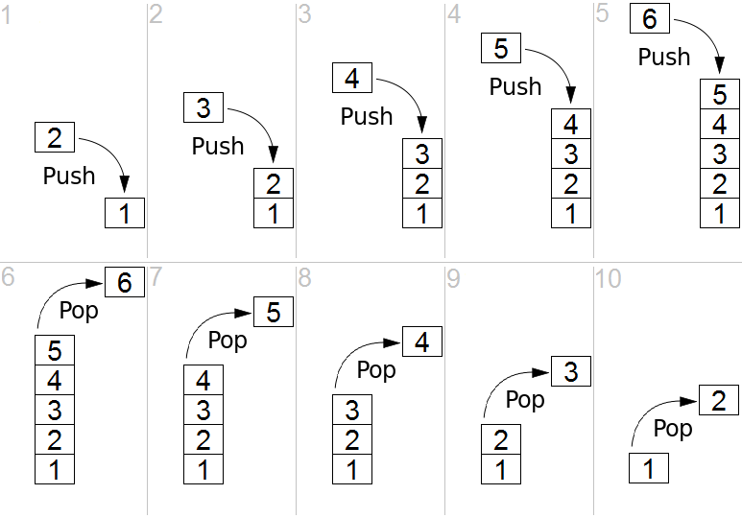
Pop and push functions
Pop → The pop operation removes an element from the top position. In other words, pop removes the most recently added that wasn’t yet removed.
Push → The push operation adds an element to the stack.

Slide 6
Our other main two functions
Display → The display function prints out the medicines which are pushed to our inventory or what’s poped later.
Delete Stack → This function delete the whole inventory.

Slide 7
The files functions
Save inventory → This function save the pushed medicines into the inventory to the file (drugs.txt) automatically.
Read file → This function read from the file (drugs.txt) when the program is used and it’s ready to display it.
Find → This function used to find a specific medicine by giving it the medicine ID.

Slide 8
Other functions
Display Options → This function dsiplays to the user our available options to the user to choose.
Menu → This function gets the selection from the user and according to this selection the functions are used.

